Slide 1
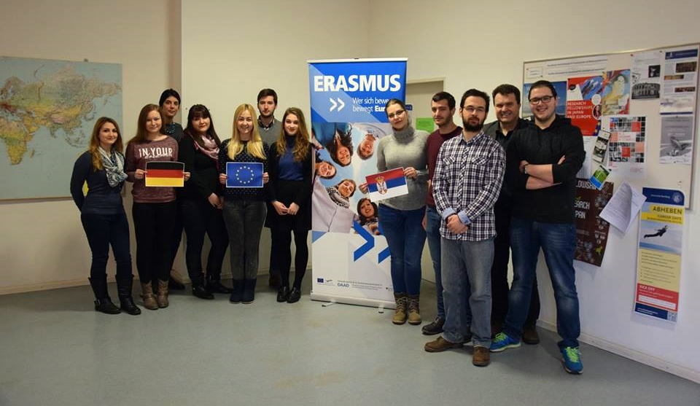

Slide 2
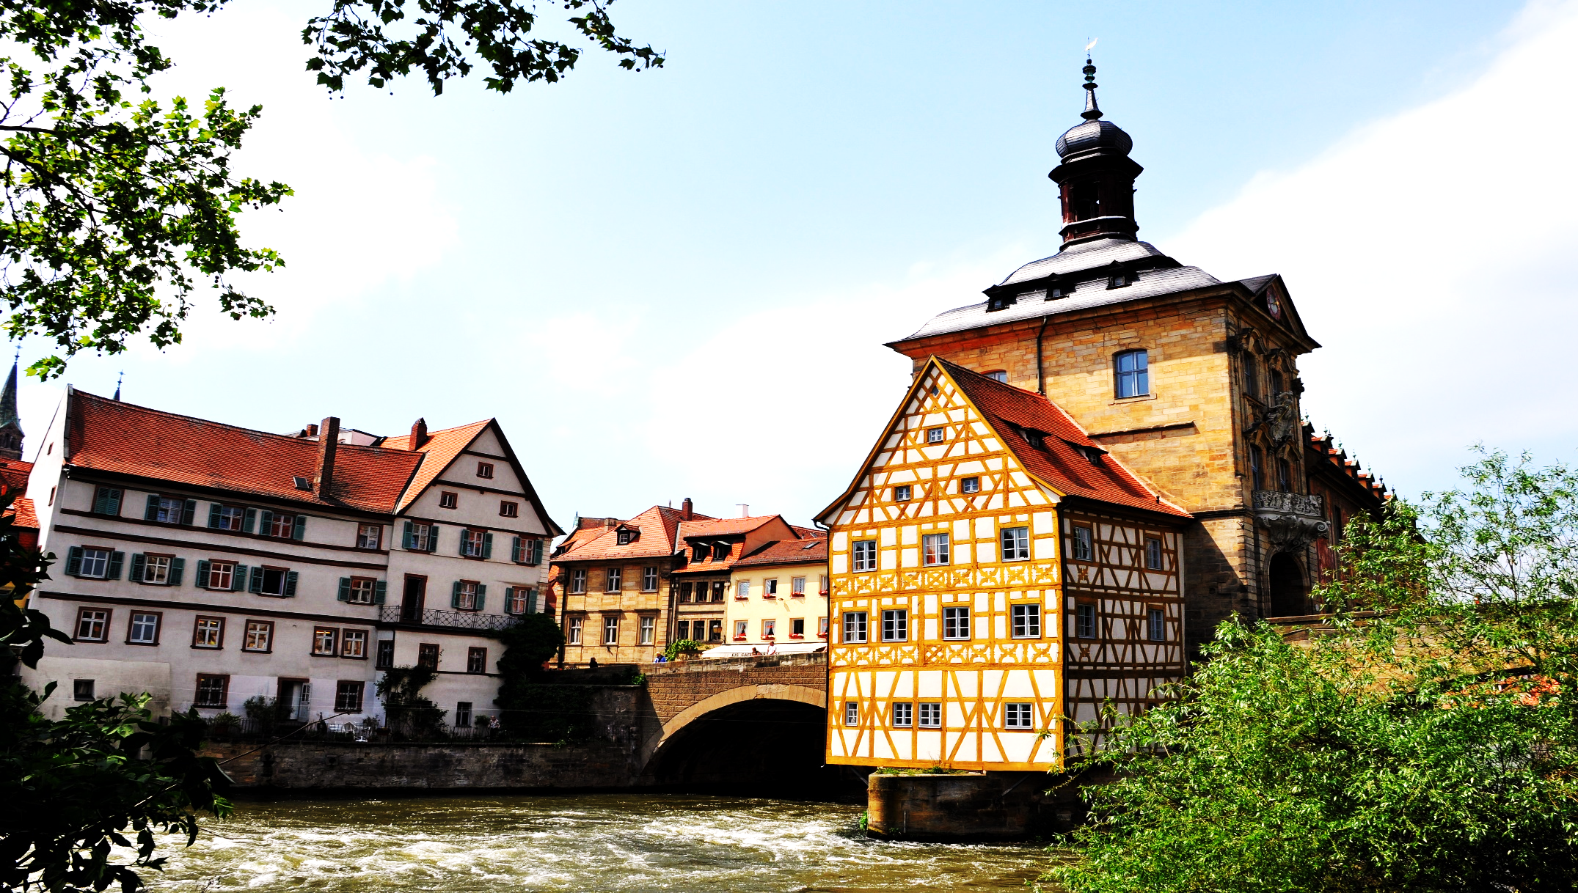

Slide 3
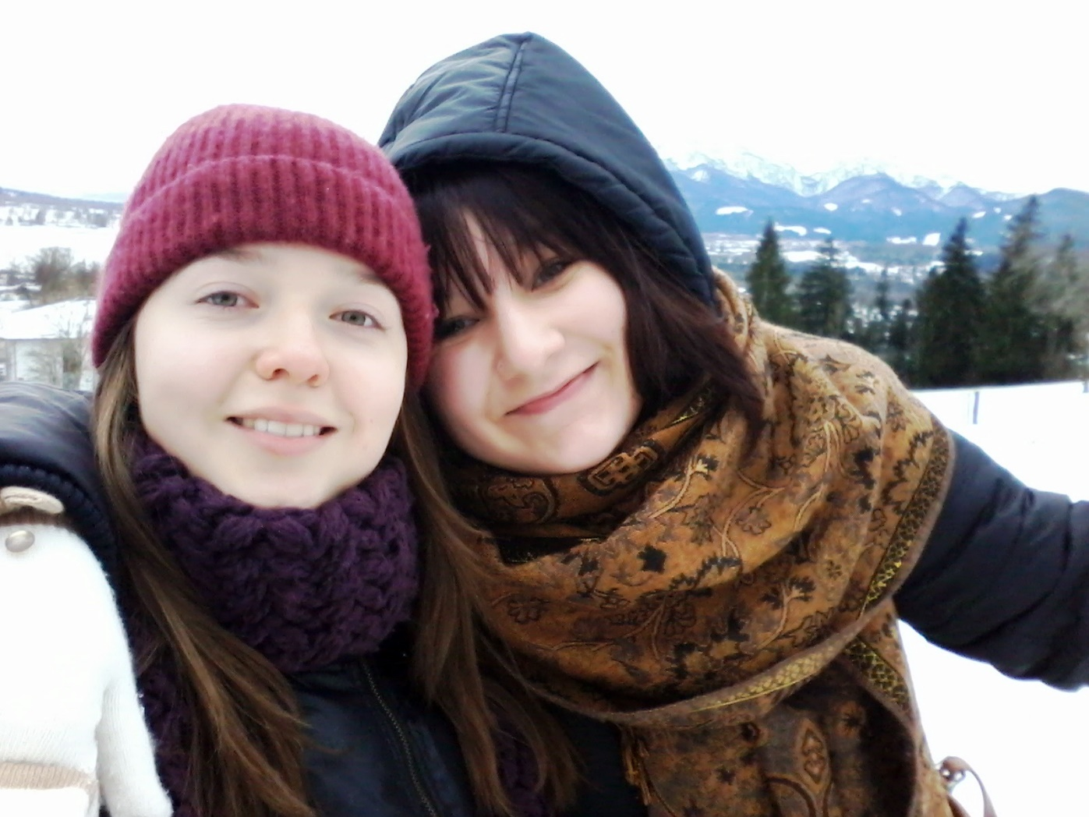

Slide 4
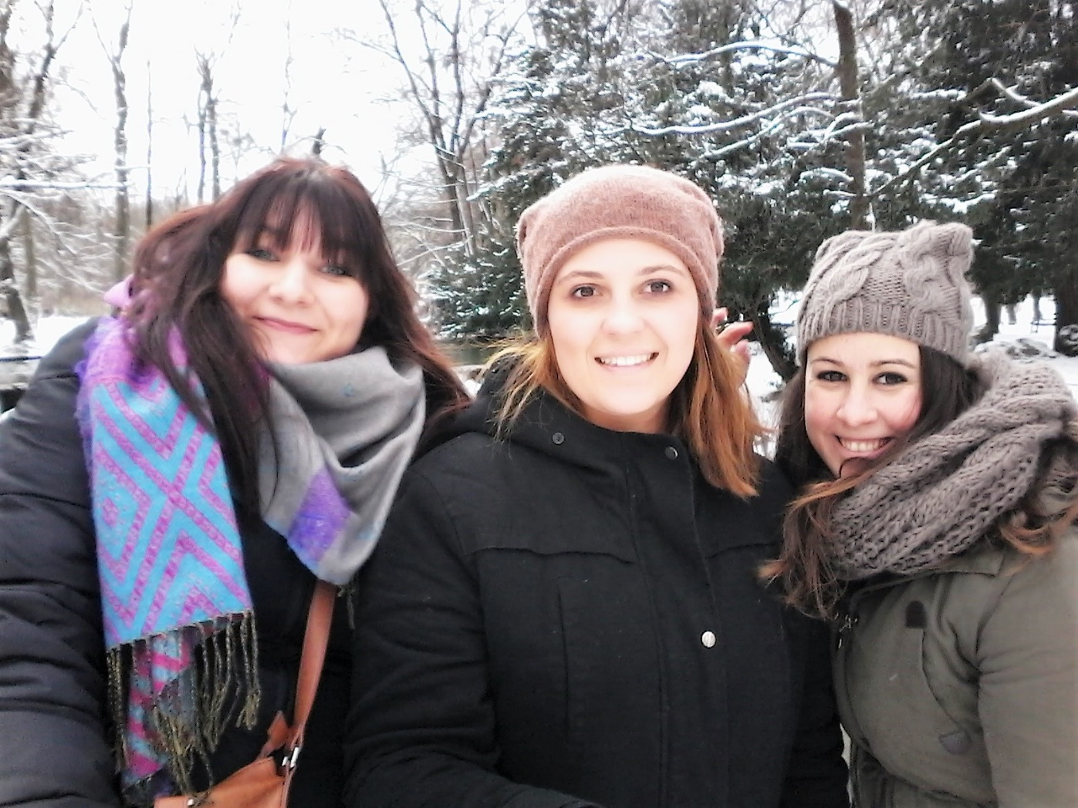

Slide 5
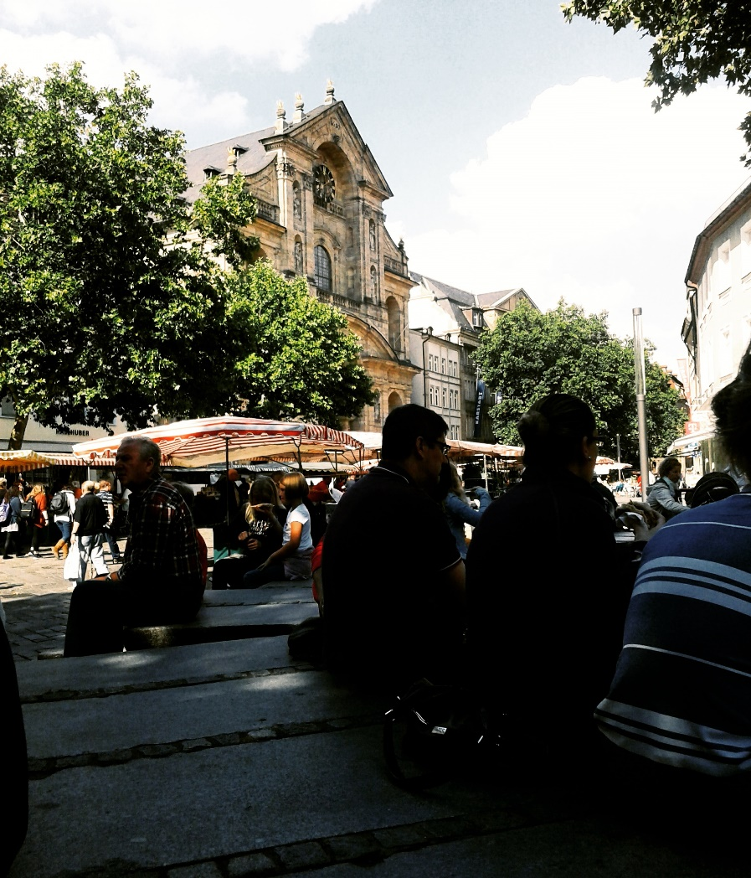

Slide 6
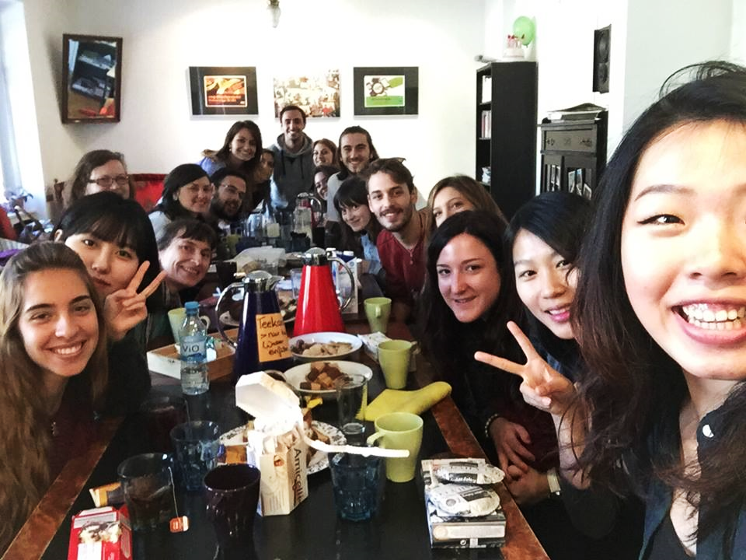

Slide 7
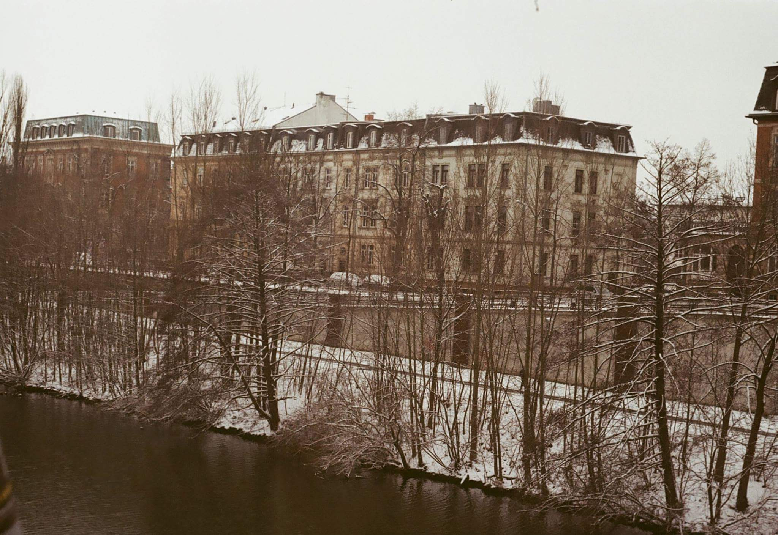

Slide 8
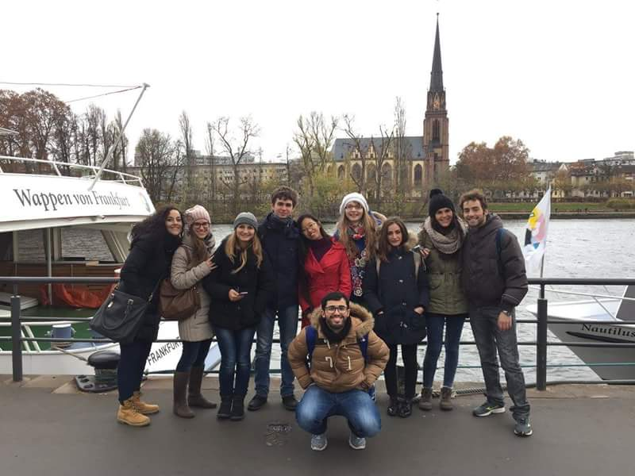

Slide 9
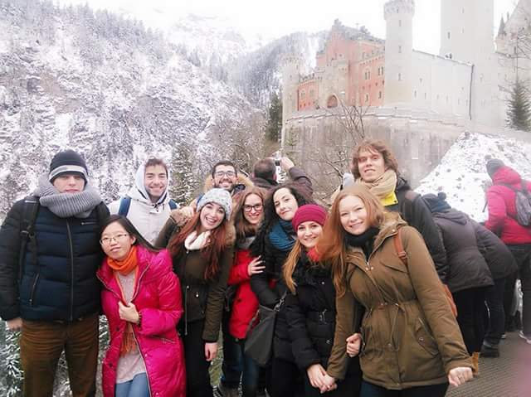

Slide 10
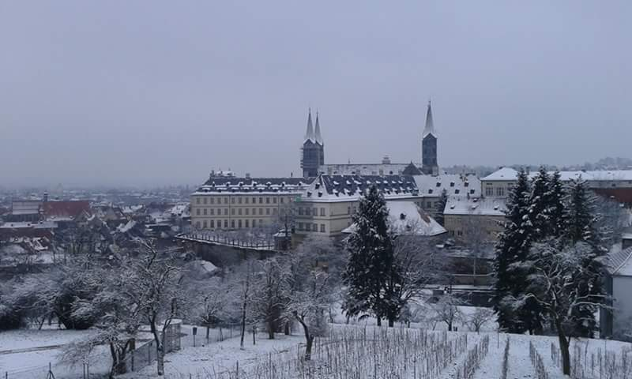

Slide 11
Being in Bamberg allowed us to meet incredible people from Europe and the world. Studying with them opened our eyes to the many differences in opinion and cultural diversity and our many shared experiences. Those are just some of the things valuable about this program. It also made it possible for us to live abroad and improve English and German. It made us more confident and independent as well as giving us an extra academic experience. We had an opportunity to see beautiful places in Bavaria and beyond whether with our group of friends or with University.
Since Bamberg is not a big city, it made it possible for us to be surrounded with our Erasmus colleagues and to get to know them all much better and form friendships that made our period in Bamberg amazing.

Slide 12
Boravak u Bambergu nam je omogućio da se upoznamo sa divnim ljudima iz Evrope i celog sveta. Studiranje zajedno sa njima nam je pokazalo kako postoje razlike u mišljenju i kulturama, kao i zajedničkim doživljajima. To su samo neke od prednosti ovog programa. Osim toga, omogućeno nam je da živimo u inostranstvu i unapredimo znanje engleskog i nemačkog jezika. Poboljšano je naše samopouzdanje i nezavisnost, kao i akademsko iskustvo. Pružena nam je prilika da posetimo prelepa mesta u Bavarskoj i šire, bilo sa našim krugom prijatelja ili sa univerzitetom.
Pošto Bamberg nije veliki grad, bile smo okružene kolegama sa Erazmus programa i tako ih bolje upoznale i sprijateljile sa njima. Ovo je učinilo nas boravak u Bambergu zaista neverovatnim.

Slide 13
We are third year undergraduate students of the College of Tourism and we were lucky enough or eligible enough to get the opportunity of studying at the University of Bamberg along with around 300 students from different corners of the planet. We were awarded a Winter Semester 2015/16 Erasmus+ scholarship. So, the city of Bamberg was the center of the world to us during the previous semester.
The Erasmus program has changed the lives of over 3 million students. I am no exception and I truly think that every student should have this kind of experience.

Slide 14
Kao studentkinje treće godine Visoke turističke škole, imale smo dovoljno sreće ili uslova da nam se ukaže prilika da studiramo na Univerzitetu u Bambergu zajedno sa 300 studenata iz različitih delova sveta. Dobile smo Erazmus + stipendiju za zimski semestar 2015/16. Tako je Bamberg postao naš centar sveta tokom prethodnog semestra.
Erazmus program je promenio živote preko 3 miliona studenata. I ja sam jedna od njih i iskreno smatram da svaki student treba da stekne ovo iskustvo.

